Slide 1


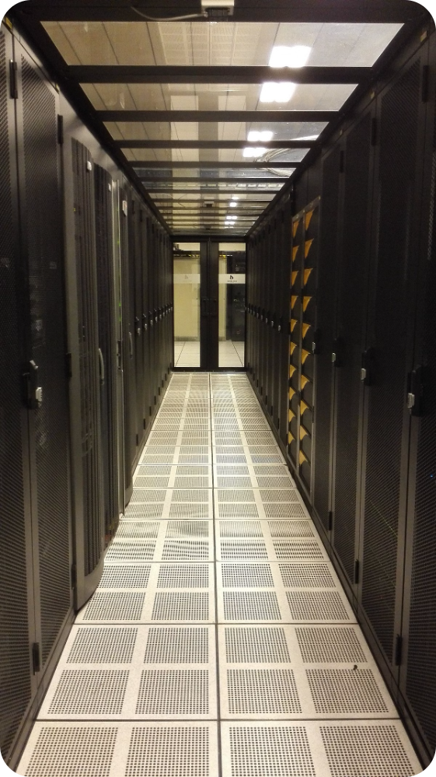
Dynamic Data Partitioning in Distributed File Systems
Distributed file systems are essential for handling large volumes of data across multiple nodes. Dynamic data partitioning optimizes data distribution, improving performance and scalability.

Slide 2
Dynamic Data Partitioning in a Distributed File System Diagram
Data Partitioning
Dynamic Partitioning
K-Means Algorithm
Data is divided into smaller units called partitions. These partitions are then distributed across different nodes in the distributed file system.
The number and size of partitions can be dynamically adjusted based on changes in data volume, usage patterns, or node availability.
The K-means algorithm is used to cluster data points into K groups based on their similarity. These clusters then form the partitions in the distributed file system.

Slide 3

Challenges in Data Partitioning
1
Data Skew
2
Data Locality
Uneven data distribution can lead to performance bottlenecks on some nodes, while others may be underutilized. This imbalance can affect overall system performance.
Data should be stored on nodes where it is most frequently accessed. This reduces network latency and improves application performance. Dynamic partitioning helps maintain data locality.
3
Scalability
4
Data Integrity
As data grows, the partitioning scheme must adapt to ensure efficient storage and retrieval. Dynamic partitioning allows for seamless scaling without impacting system performance.
Partitioning must be designed to ensure data consistency and integrity, especially during data updates or modifications.

Slide 4
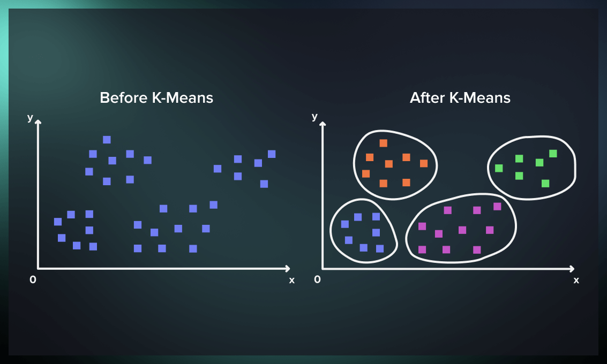
Overview of the K-means Algorithm
Initialization
Assignment
Update
The algorithm starts by randomly selecting K centroids (representative data points) in the data space.
Each data point is assigned to the closest centroid based on a distance metric. This forms K clusters.
The centroids are then recalculated as the mean of all data points assigned to each cluster. This process iterates until convergence.

Slide 5


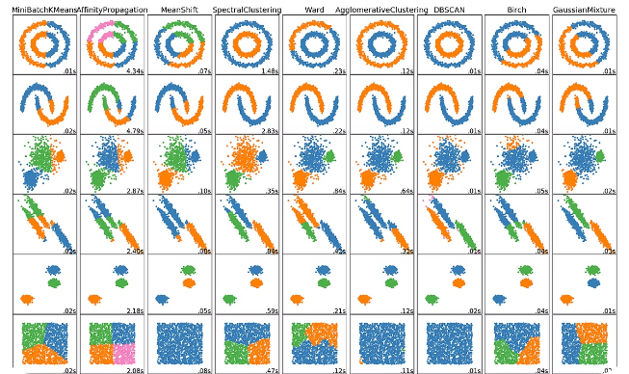


Applying K-means for Data Partitioning
Data Representation
Data points are represented as vectors, each dimension corresponding to a feature or attribute. For example, a file's size, last modified timestamp, or content hash could be used as features.
Clustering
K-means is applied to cluster these data points, grouping them based on their similarity in features.
Partition Assignment
Each cluster is assigned to a specific node in the distributed file system. This ensures that similar data is stored on the same node, improving data locality.

Slide 6
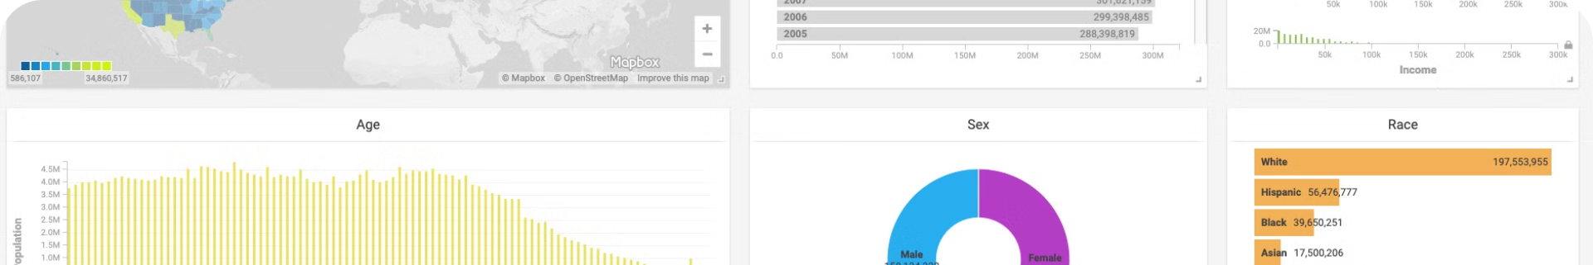
Advantages of Dynamic Data Partitioning
Increased Scalability
Handles growing datasets and node additions without major system disruptions.
Improved Performance
Reduces network traffic and improves data locality, leading to faster data retrieval and processing.
Enhanced Data Locality
Data is stored on nodes where it is most frequently accessed, resulting in reduced latency and faster access times.
Adaptive Data Distribution
The system can automatically adjust partitioning based on data volume, access patterns, or node availability.

Slide 7
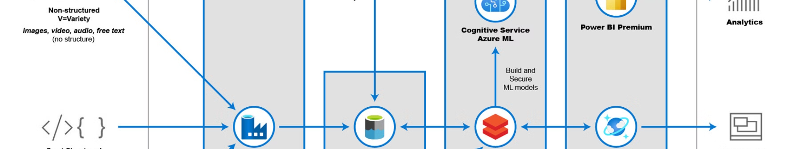




Implementation Details
Data Representation
K-means Implementation
Partitioning Mechanism
Monitoring and Optimization
Data is stored in a distributed data store, such as a distributed file system or a NoSQL database.
The K-means algorithm can be implemented using various frameworks or libraries, such as Apache Spark or Hadoop.
The system needs to maintain metadata about partition assignments and distribute this information to nodes.
The system should monitor performance metrics and dynamically adjust partitioning based on observed patterns.

Slide 8

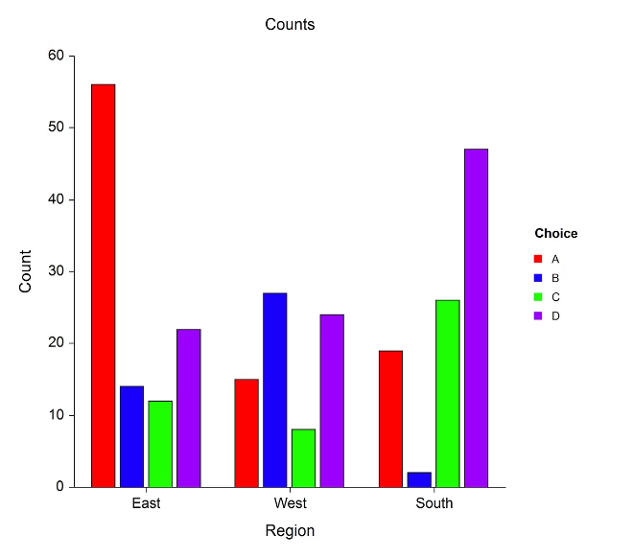
Evaluation and Performance Analysis
1
Baseline Performance
Measure the performance of the system with static data partitioning. This acts as a reference point for comparison.
2
Dynamic Partitioning Evaluation
Compare the performance of the system with dynamic partitioning using K-means. Analyze metrics such as data retrieval time, network traffic, and resource utilization.
3
Performance Tuning
Identify performance bottlenecks and optimize the system by adjusting parameters such as the number of partitions, cluster size, and data distribution strategy.

Slide 9
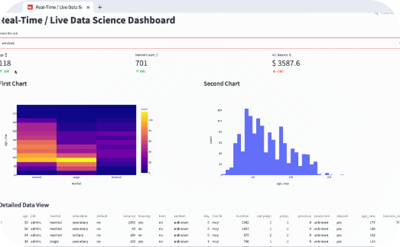

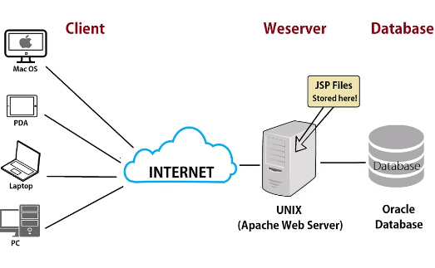
Real-Time Applications
Streaming Data Analysis
E-commerce Platforms
Web Server Infrastructure
Dynamic partitioning helps manage rapidly changing data in real-time applications, such as online transaction processing or social media analytics.
Distributed file systems with dynamic partitioning support efficient storage and retrieval of product catalogs, user preferences, and order information.
Distributing web content across multiple nodes with dynamic partitioning improves performance and scalability, handling large user traffic and content updates.

Slide 10


Conclusion and Future Work
Dynamic data partitioning, powered by K-means clustering, significantly enhances distributed file systems. Future research can focus on optimizing K-means for dynamic environments and exploring alternative clustering algorithms.

